Slide 1



A Medical Insurance Cost Classification Model
Abhinav Prakash Krishna Singh
Aaditya Aanand Amitesh Ranjan
Presented By
Priyanshu Kumar Ayush Keshri
Under The Guidance of DR. DIPTI DASH

Slide 2


Overview
Introduction
Problem Statement & Objective
Project Workflow
Methodology
Data Overview
Data Preprocessing & EDA
Train-Test Splitting & Validation Strategy
Normalization
Hyperparameter Tuning
Conclusion & Result
Reference

Slide 3

InsuriFy leverages machine learning to offer a data-driven, personalized approach to insurance cost forecasting.
Introduction
This not only helps insurers in accurately pricing policies and managing risks but also empowers consumers by offering transparency and personalized insights into their potential insurance expenses.
Motivation:
Rising healthcare costs require dynamic pricing models.
Need for transparency and precision in risk evaluation.
Benefit for both insurers and policyholders.

Slide 4
Problem Statement & Objective
Problem Statement:
"Current insurance pricing models rely on generalized risk assessments and outdated statistical methods, leading to overpricing or underpricing of policies. This mispricing can create imbalances, exposing insurers to risk and customers to unexpected costs."
Objectives:
Develop a robust classification-based model to predict insurance costs.
Utilizing Demographic & Health-Related Data: This means integrating various personal and health metrics for a more tailored risk assessment.
Leveraging Machine Learning: To enhance prediction accuracy, ensuring that the model can adapt and learn from the data for better forecasting.
Deliver Actionable Insights: Provide clear, interpretable outputs for both insurers and policyholders.

Slide 5
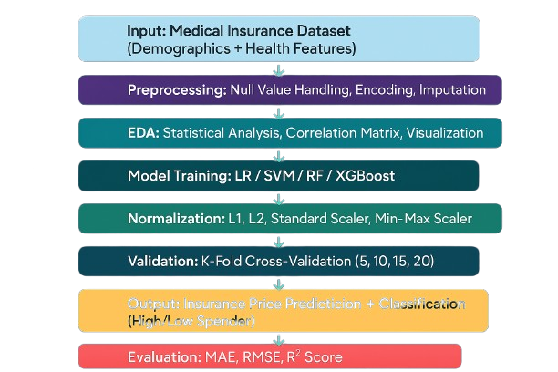

Project Workflow
Output: Insurance Price Predicticion + Classification
(High/Low Spender)
Evaluation: Accuracy, Precision, Recall, F1 Score

Slide 6
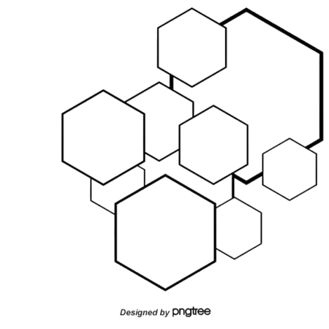
Methodology
Data Collection:
Data Preprocessing & EDA:
Use of real-world medical insurance dataset (features: age, BMI, smoking status, region, number of children, etc.).
Handling missing values, encoding categorical variables, and exploratory analysis.
Model Training:
Normalization:
Trained multiple regression models to identify the most effective algorithm for cost prediction.
Applied various normalization techniques to stabilize and optimize model training.
Validation:
Output:
Used k-fold validation to assess model performance
Generated categorized individuals based on spending profiles.
Evaluation:
Evaluated models using standard regression metrics to measure accuracy and error rates.

Slide 7
📊
Dataset Overview
Source:
KAGGLE (insurance_classification.csv)
Features:
Age, Sex, BMI, Children, Smoker status, Region
Target Variable:
Charges: Converted to binary classification
0 - Low Spender
1 - High Spender
Initial Data Processing:
Encoded categorical variables (Sex, Smoker, Region) using Label Encoding
Verified absence of null values
Ensured data types are consistent for ML modeling

Slide 8
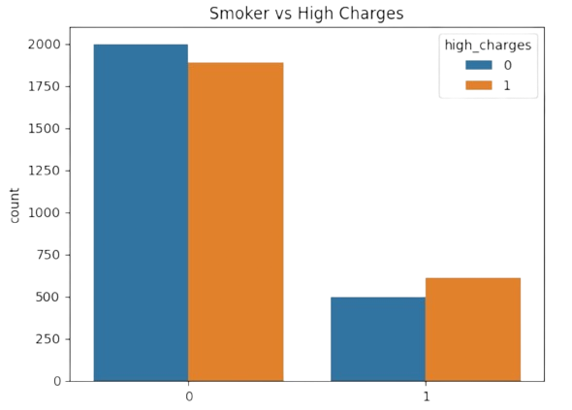

Data Preprocessing & Exploratory Data Analysis (EDA)
Data Cleaning & Transformation:
"We began by addressing missing values with appropriate imputation techniques and converted categorical features into numerical representations using encoding methods.
Exploratory Analysis:
Visualization of feature distributions (e.g., age, BMI, insurance charges).
Correlation analysis to identify relationships between variables.
Outlier detection and handling.

Slide 9


Train-Test Splitting & Validation Strategy
Train-Test Splitting
We experimented with various train-test splits (80:20, 70:30, 60:40) to determine the optimal balance between training the model and validating it on unseen data.
It prevents reliance on a single evaluation set and reduces the risk of biased metrics.
Cross-Validation: K-Fold Approach
Implemented K-Fold Cross-Validation with k = 5, 10, 15, 20.
The dataset is divided into k parts; each part takes a turn as the test set while others are used for training.
Ensures more reliable and stable evaluation of model performance.
Benefits of This Strategy
Minimizes overfitting and variance.
Provides a better performance.
Ensures that the model is not just memorizing but learning meaningful patterns.

Slide 10
Normalization
Why Normalize ?
Different features like age, BMI, and children have varying scales.
Normalization brings all features to a common scale for improved convergence and stability.
Techniques Applied:
L1 Normalization: Scales data based on the sum of absolute values.
L2 Normalization: Uses the Euclidean norm for scaling.
Standard Scaler: Standardizes features by removing the mean and scaling to unit variance.
Min-Max Scaler: Rescales features to a range of 0 to 1.
Outcome:
Normalization significantly improved model convergence and reduced training time.
Helped algorithms like SVM and XGBoost perform more consistently across features.

Slide 11


Hyperparameter Tuning
Each model is fine-tuned using four key hyperparameters - for example:
SVM (Support Vector Machine):
C: Regularization parameter
kernel: Type of kernel function (e.g., linear, RBF)
gamma: Defines influence of a single training example
degree: Degree of the polynomial kernel
Logistic Regression:
C: Regularization strength
penalty: Type of regularization (e.g., L2)
solver: Algorithm to use in optimization
max_iter: Maximum number of iterations
Random Forest:
n_estimators: Number of trees in the forest
max_depth: Maximum depth of each tree
min_samples_split: Minimum samples required to split an internal node
criterion: Function to measure the quality of a split
XGBoost:
n_estimators: Number of boosting rounds
max_depth: Maximum tree depth
learning_rate: Step size shrinkage
subsample: Fraction of samples used per tree

Slide 12


Results
F1 Score
Accuracy
Precision
Recall
Comparison of Model Performance Metrics

Slide 13

Conclusion
We developed InsuriFy, a machine learning-based system to classify whether a medical insurance premium is high, using consumer and demographic data.
Classification models like SVM, Random Forest, Logistic Regression, and XGBoost were implemented and compared using a structured pipeline:
data cleaning → normalization → model training → evaluation → hyperparameter tuning.
A detailed exploratory data analysis was performed to understand the impact of features such as age, BMI, smoking status, and region on insurance charges.
Multiple normalization techniques (L1, L2, MinMax, Standard) were tested to find the most effective preprocessing path.
Cross-validation and key metrics (Accuracy, F1 Score, Precision, Recall) ensured fair and reliable model evaluation.
Random Forest and XGBoost outperformed other models in terms of both F1 Score and generalization.
The system can assist insurance companies in evaluating client risk profiles and assigning appropriate premiums.

Slide 14
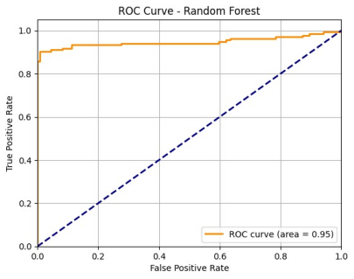
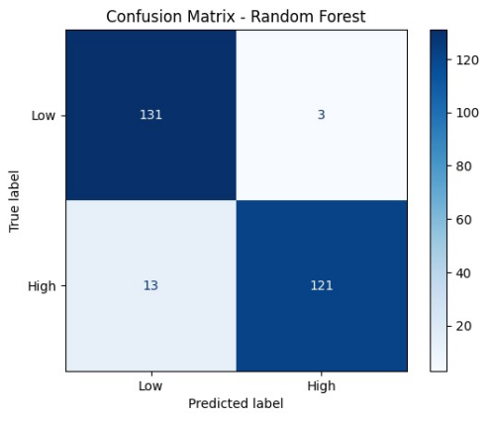
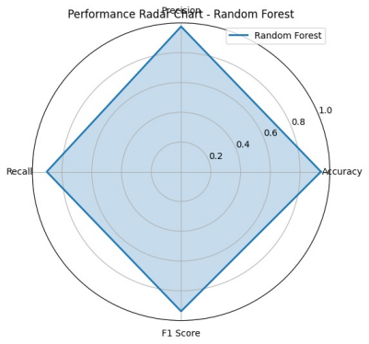

Conclusion and Result
ROC Curve - Random Forest
Confusin Matrix-Random Forest
Performance Raidal Chart-Random Forest

Slide 15


References
Scikit-learn: Machine Learning in Python –
Pedregosa, F., et al. (2011). Journal of Machine Learning Research, 12, 2825–2830.
https://scikit-learn.org
XGBoost: A Scalable Tree Boosting System –
Chen, T., & Guestrin, C. (2016). Proceedings of the 22nd ACM SIGKDD Conference.
https://dl.acm.org/doi/10.1145/2939672.2939785
1. Health Insurance Cost Prediction using Machine Learning Algorithms –
Rahman, M. M., et al. (2020). IEEE International Conference on Artificial Intelligence.
DOI: 10.1109/ICAIE50891.2020.9358395
1. IBM Analytics Community – Understanding Exploratory Data Analysis (EDA) –
https://community.ibm.com/community/user/datascience/blogs/
1. Medical Cost Personal Dataset from Kaggle –
https://www.kaggle.com/datasets/mirichoi0218/insurance

Slide 16

























Thank You :)
Developed and Presented by:
22052262 - Abhinav Prakash
22052466 - Krishna Singh
22052521 - Aaditya Aanand
22052530 - Amitesh Ranjan
22052572 - Priyanshu Kumar
22053413 - Ayush Keshri

